Slide 1
Creating Web Page Forms
.

Slide 2
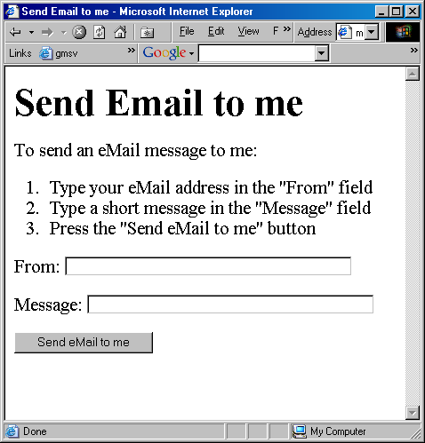

Slide 3
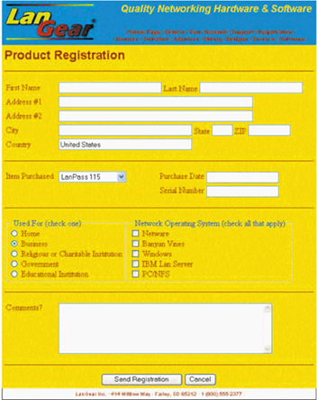
Completed Registration Form
contact information
product information
usage information
comments
buttons

Slide 4
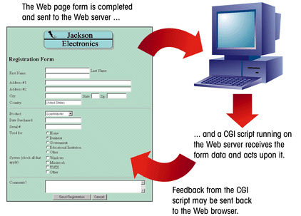
The Interaction between a
Web Page Form and a CGI Script
This figure shows how a Web page form interacts with a CGI script.

Slide 5
Working with CGI Scripts
HTML supports tags for creating forms, however, it does not process the information.
Use CGI (Common Gateway Interface) script to process form information.
CGI script runs on the Web server and receives data from a form and uses it to perform a set of tasks.
Web page designers may not be able to create or edit CGI scripts.
  Internet Service Providers (ISPs) and universities may provide CGI scripts that their customers and student can use on their Web sites, but which they cannot directly access or modify

Slide 6
The <form> Tag
A single page can include several different forms, but you cannot nest one form inside another.
The general syntax of the <form> tag is:
  <form attributes>
  form elements and layout tags
  </form>
A single Web page can contain multiple forms, the <form> tag includes the name attribute.
The name attribute identifies each form on the page.
The name attribute is also needed for programs that retrieve values from the form.

Slide 7


Adding the <form> Tag
The <form> tag includes attributes that control how the form is processed, including information on what CGI script to use, how the data is to be transferred to the script, and so forth.
This figure shows the form name “reg.”

Slide 8
Form Components and Elements
Input box
First Name
Last Name
Address #1
Address #2
City
State
Zip
Country
Item Purchased
Purchase Date
drop-down list box
Serial Number
group box
Used For (check one)
Network Operating System (check all that apply)
Home
Netware
Business
Banyan Vines
radio buttons
Religious or Charitable Institution
Windows
Government
IBM Lan Server
check boxes
Educational Institution
PC/NFS
Comments?:
text area
Send Registration
Cancel
form button

Slide 9
Form Control Elements
Control elements :
  text boxes for text and numerical entries
  selection lists for long lists of options, usually appearing in a drop-down list box
  radio buttons, also called option buttons, to select a single option from a predefined list
  check boxes to specify an item as either present or absent
  groups boxes to organize form elements
  text areas for extended entries that can include several lines of text
  buttons that can be clicked to start processing the form
Each control element in which the user can enter information is called a field.

Slide 10
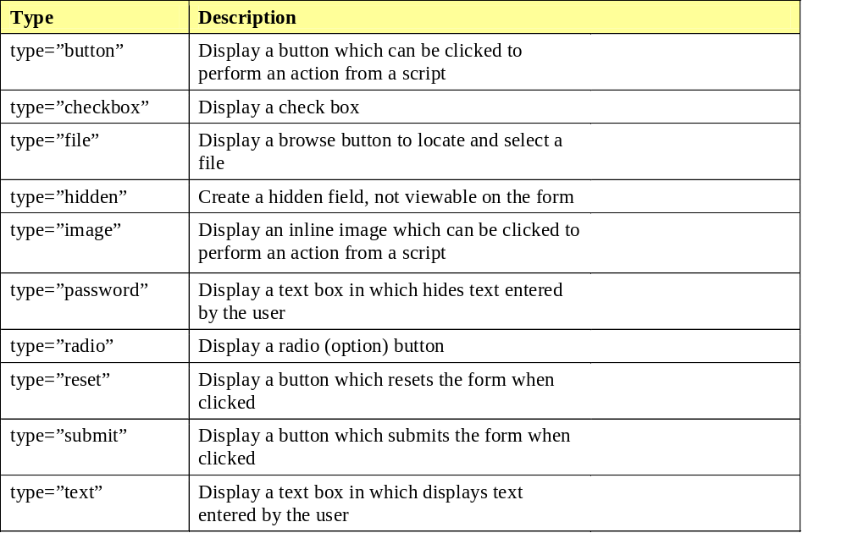
Input Types

Slide 11
Forms
Form Input: INPUT
  Only used within a FORM element and is denoted by <INPUT>.
  Attributes:
    NAME: The name of the particular element.
    MAXLENGTH: The maximum number of characters that can be entered by users in a text field.
    SIZE: Specifies the size of the field and depends on its type.
    SRC: Denote URL for an image.
    VALUE: Contain the initial value displayed to users.
    TYPE: Defines the type of data used in the field.
    CHECKED: Indicates that a checkbox or radio button is selected.
    DISABLED: Prevents the field from receiving focus.
    ALIGN: Alignment if image is used.
    READONLY: Prevents modification of the contents of the field.

Slide 12
1. Working with Text Boxes
Text boxes are created using the <input> tag.
The general syntax is:
  <input type=“type” name=“name” id=“id”>
  type specifies the type of input field
  name and id attributes identifies the input field for the CGI script
To create a text box, you would enter the tag:
  <input type=“text”>

Slide 13
Creating a Text Box
To create a text box, use the following HTML code:
  <input name=“name” id=“id” value=“value” size=“value” maxlength=“value”>
  name and id attributes identify the field
  value - a default value to the text box
  size - the width of the text box in number of characters
  maxlength - the maximum number of characters allowed in the field

Slide 14
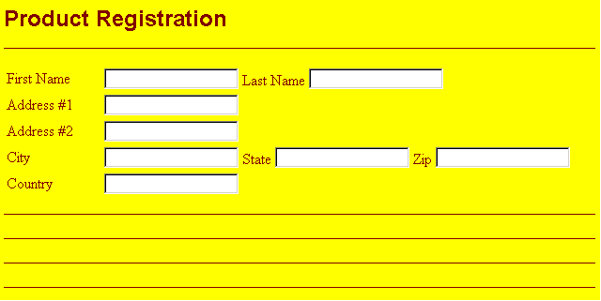
Text Boxes on the Form
Text boxes are blank and do not contain any accompanying text, a text description needs to be inserted, such as “Last Name”, adjacent to each box so that the user knows what to enter.
text description
text box

Slide 15
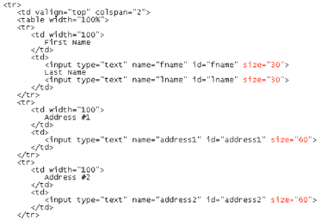
Setting the Width of Text Boxes

Slide 16

Specify the Maximum Length for a Field
This figure shows an example of limiting the width of the zip code field to five characters.
no more than 5 characters are allowed in this text box

Slide 17
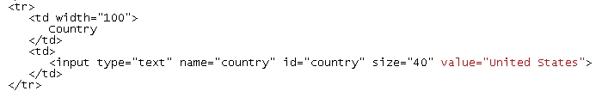
Defining a Default Value for a Field
If customers from countries other than the United States use this Web form,
they can remove the default value by selecting the text and pressing the Delete key.
default value

Slide 18
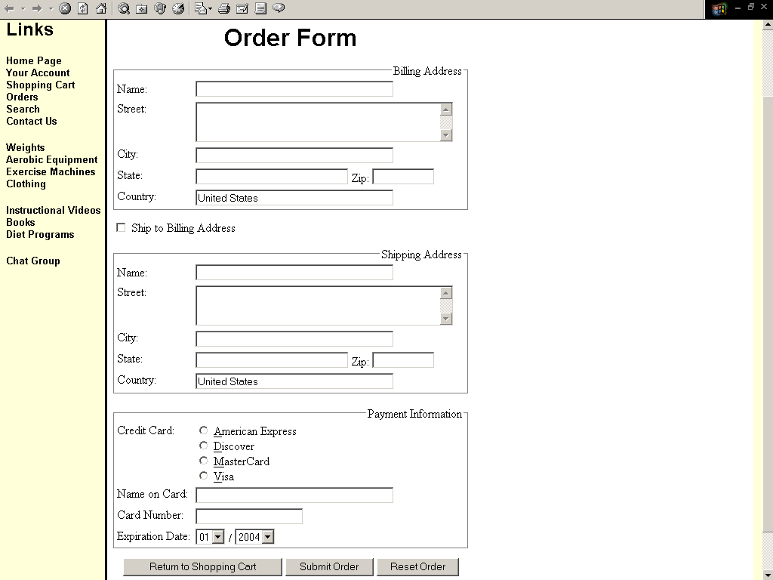
Value =“United States”

Slide 19
2. Creating a Password Field
A password field is a text box in which the characters typed by the user are displayed as bullets or asterisks i.e. ****.
The syntax for creating a Password field is:
  <input type=“password”>
Using a password field should not be confused with having a secure connection.
The password itself is not encrypted.
The password field only acts as a mask for a field entry as it is entered.

Slide 20
3. Form Labels
HTML allows you to formally link a label with an associated text element for scripting purposes.
The syntax for creating a form label is:
  <label for=“id”>label text</label>
  id is the value of the id attribute for a field on the form
  label text is the text of the label
  you must bind the label to the id attribute of the field and not the name attribute

Slide 21

Creating a Label for the fname Field
This figure shows a label for the fname field.
value of the id attribute for the first name field

Slide 22
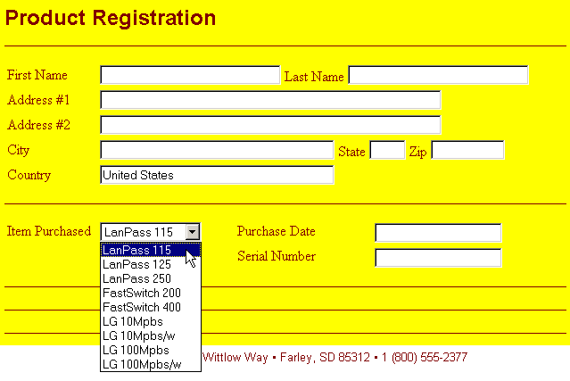
3. Using a Selection List
Your selection list might look slightly different depending on the browser and browser version.

Slide 23
Creating a Selection List
A selection list is a list box from which a user selects a particular value or set of values.
Selection lists are good to use when there is a fixed set of possible responses.
Selection lists help prevent spelling mistakes and erroneous entries.
A selection list is created using the <select> tag.
The <option> tag is used to specify individual selection items.

Slide 24
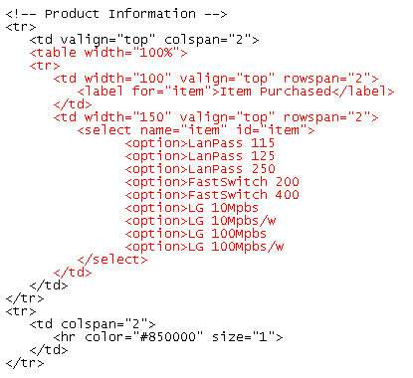
Creating a Selection List
selection list field name
items in the selection list

Slide 25

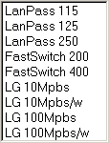
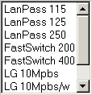
Selection Lists with
Different Size Values
size = "1"
size = "4"
size = "7"
size = "9"

Slide 26
Working with Option Values
By default, a form sends the values that are displayed in the selection list to the CGI script.
Instead of sending an entire text string, an abbreviation or code can be sent to the CGI script.
Specify the value that is sent to the CGI script with the value attribute.
Use the selected attribute to specify which item in the selection is selected, or highlighted, when the form is displayed.

Slide 27
Working with Option Groups
The most recent releases of HTML allows you to organize selection lists into distinct groups called option groups.
The syntax for creating an option group is:
  <optgroup label=“label”>
  label is the label assigned to the option group
  the text for the label appears in the selection list above each group of items but is not a selectable item from the list

Slide 28
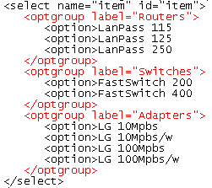
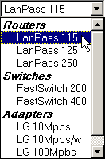
Option Groups
Internet Explorer and Netscape versions prior to 6.0 display
the selection list without the group labels.
option group label
option group label
a single option group
a single option group

Slide 29
4. Radio Buttons
Radio buttons display a list of choices from which a user makes a selection.
  Only one radio button can be selected at a time.
The syntax to create a radio button is:
  <input type=“radio” name=“name” id=“id” value=“value”>
  name - the field containing the radio button (required)
  id - the specific option. Only required if you intend to use a field label with the radio button
  value - the value sent to the CGI script, if that radio button is selected by the user

Slide 30
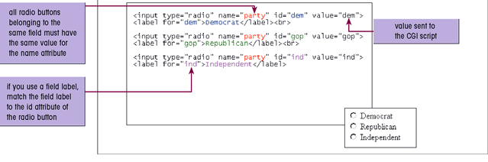
Creating Radio Buttons
In this sample code, the value sent to the CGI script does not match the field label.
If the user selects the Republican radio button, the value “gop”
is sent to the CGI script paired with the field name “party.”

Slide 31
5. Working with Check Boxes
A check box is either selected or not
Check boxes are created using the following syntax:
  <input type=“checkbox” name=“name” id=“id” value=“value”>
  name and id - the check box
  the value - the value that is sent to the CGI script when the check box is selected
Check boxes are not selected by default.
  to do this, add the checked attribute to the <input> tag
  <input type =“checkbox” checked = “checked”>

Slide 32
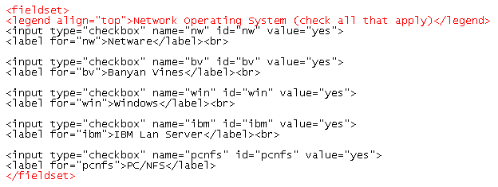
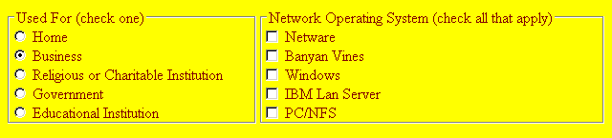
Group Boxes for Radio Buttons and Check Boxes

Slide 33
6. Creating a Group Box
A group box labels an entire collection of radio buttons.
A group box is a box placed around a set of fields that indicates that they belong to a common group.
The syntax for creating a group box is:
  <fieldset>
  <legend align=“top”>legend text</legend>
  collection of fields
  </fieldset>

Slide 34
Creating a Field Set
HTML and XHML allow you to organize option buttons into a group of fields called field sets.
  Most browsers place a group box around a field set to indicate that the fields belong to a common group.
  <fieldset>
  fields
  </fieldset>
  Where fields are the individual fields within a set.
the <legend> tag is used to display a legend on the group box

Slide 35
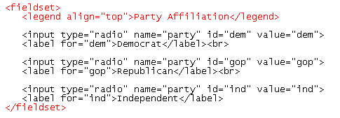

Creating a Group Box and Legend
start of group box
group box legend
resulting radio buttons and group box

Slide 36
Group Boxes for Radio Buttons and Check Boxes

Slide 37

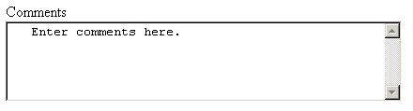
7. Creating a Text Area
default text area text
dimensions of text area
resulting text area

Slide 38
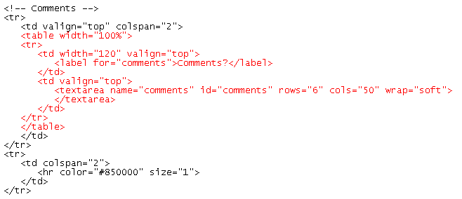
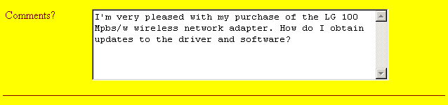
Comment Text Area

Slide 39
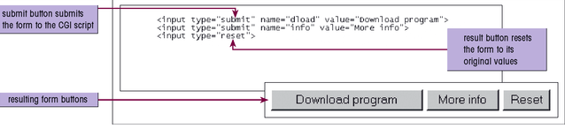
8. Creating a Form Button

Slide 40
Creating a Push Button
One type of button, called a push button, is created using the <input> tag as follows:
  <input type=“button” value=“text”>
  text is the text that appears on the button
By themselves, push buttons perform no actions in the Web page.
To create an action, write a script or program that runs automatically when the button is clicked.

Slide 41
Creating Submit and Reset Buttons
A submit button is a button that submits the form to the CGI script for processing.
A reset button resets the form to its original (default) values.
The syntax for creating these two buttons is:
  <input type=“submit” value=“text”>
  <input type=“reset” value=“text”>
  value attribute defines the text that appears on the button

Slide 42
Creating a Form Button
The figure shows HTML tags for buttons that download a program,
retrieves information, and resets the form to its original values.

Slide 43

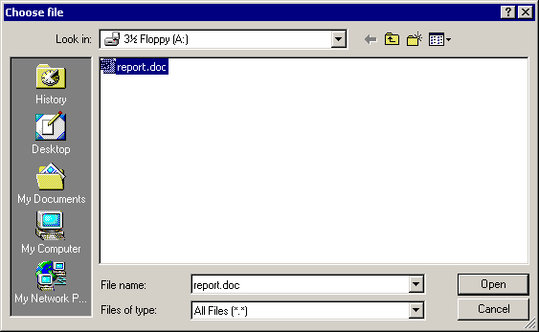

9. Creating a File Button
The figure shows an example of using the file button to return the location of a file named “report.doc.”
1. User clicks the Browse button
2. Selects a file from the Choose File dialog box
3. The filename and location are automatically placed in the text box

Slide 44
10. Working with Hidden Fields
A hidden field is added to the form but not displayed in the Web page.
Because the field is hidden, it can be placed anywhere between the opening and closing <form> tags.
The syntax for creating a hidden field is:
  <input type=“hidden” name=“name” value=“value>
Place all hidden fields in one location to make it easier to read and interpret the HTML code.
Include a comment describing the purpose of the field.

Slide 45
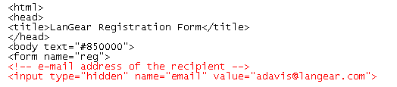
Adding a Hidden Field
This figure shows an example of the hidden field code.

Slide 46
Working with Form Attributes
After adding the elements to your form, you’ll need to specify where to send the form data and how to send it. Use the following attributes:
  <form action=“url”method=“type”enctype=“type”>… </form>
  URL - the filename and location of the CGI script that process the form
  Method - how your Web browser sends data to the CGI script
  enctype - the format of the data stored in the form’s field

Slide 47
Working with Form Attributes
The method attribute can have one of two values:
  Post
  Get
The get method is the default;
  get appends the form data to the end of the URL specified in the action attribute.
The post method sends form data in a separate data stream, allowing the Web server to receive the data through “standard input”.
  the “post” method is considered the preferred way of sending data to a Web server

Slide 48
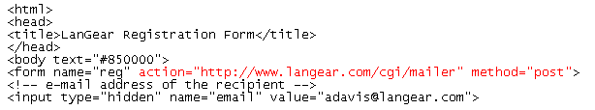
Specifying Where and How to Send Form Data
This figure shows the CGI script that processes the form is located at the URL http://www.langear.com/cgi/mailer (a fictional address) and uses the “post” method.

Slide 49
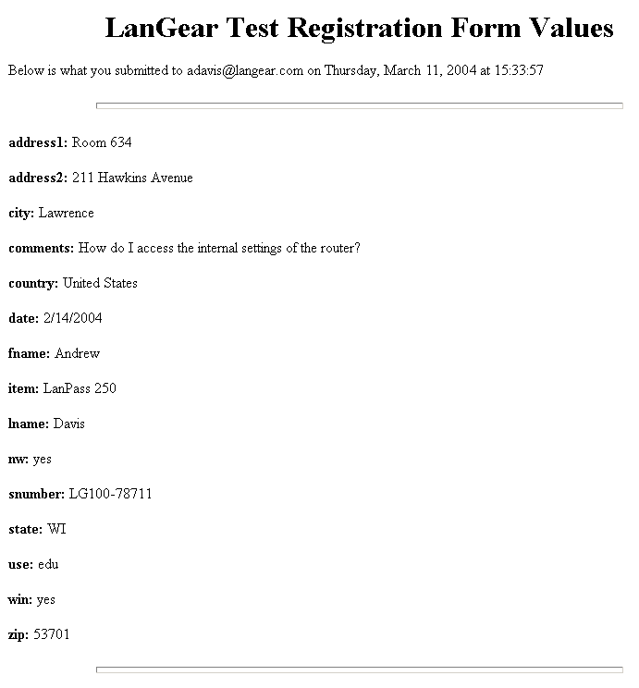
Form Values
The Web browser presents a page, an example of which is shown in this figure, displaying the name of each field in the form and the value assigned to it. At the same time, the CGI script formats a mail message to be sent to the address you entered.

Slide 50
Using the “mailto” Action
Use the “mailto” action to send form information via e-mail without using a CGI script.
This action accesses the user’s own e-mail program and uses it to mail form information to a specified e-mail address, bypassing the need for using CGI scripts on a Web server.
The syntax of the “mailto” action is:
  <form action=“mailto:e-mail_address” method=“post” enctype=“text/plain”>
  e-mail_address is the e-mail address of the recipient of the form

Slide 51
Using the “mailto”
Action Continued
Not all browsers support the “mailto” action.
  for example, versions of Internet Explorer earlier than 4.0 and Netscape Navigator 3.0 do not
Another concern is that messages sent via the “mailto” action are not encrypted for privacy.
The recipient’s email address is revealed to the user.

Slide 52
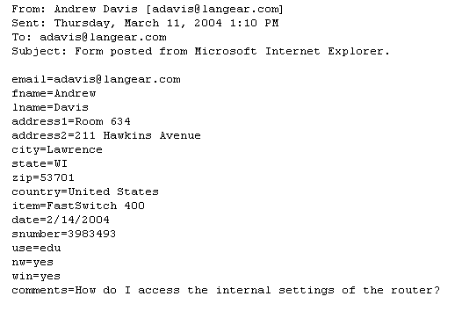
Mail Message Created Using the “mailto” Action
This figure shows an e-mail message that the “mailto” action generated for a registration form.
The format of the mail message may look different depending on the browser or e-mail software.

Slide 53
Specifying the Tab Order
Users navigate through a Web form using the Tab key.
  the Tab key moves the cursor from one field to another in the order that the field tags are entered.
Add the tabindex attribute to any control element in the form to specify the tab order.
With each element assigned a tab index number, the cursor moves through the fields from the lowest index number to the highest.
  for example, to assign the tab index number “1” to the fname field, enter the code: <input name=“fname” tabindex=“1”>

Slide 54
Specifying an Access Key
An access key is a single key that you type in conjunction with the Alt key for Windows users or the Command key for Macintosh users, to jump to one of the control elements in the form.
Add the accesskey attribute to any of the control elements to create an access key.
To create an access key for the lname field, enter the following code: <input name=“lname” accesskey=“1”>
  if a user types Alt+l (or Command+1 for Macintosh users), the control element for the lname field is selected

Slide 55
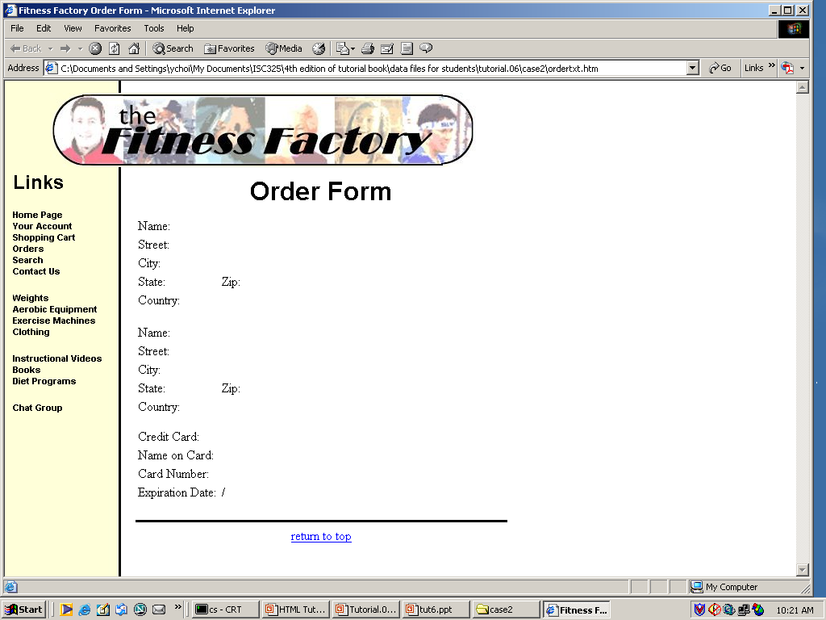
7 rows

Slide 56
<form> tag needed after <body>
Three <Fieldset> with <legend>
for group box
<textarea> for “street field”
Default value as “United States”
needed for “Country”
Checkbox for “Ship to Billing
Address” field
Radio button for Credit Card field
“password” as input type” for
card number field
<select> and <option> for
“expiration date” field
Three form buttons at the bottom

